Slide 1

Swift Trust
Building Community
for Student Success
Presented by: Kim George and Brice Olivier

Slide 2
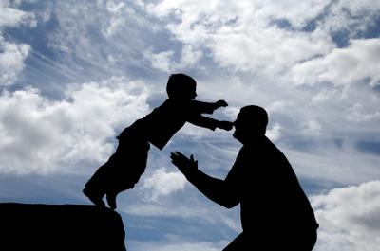
What We See

Slide 3

What They See

Slide 4
What is Trust?
Wheeless and Grotz (1977) define individualized trust as:
a process of holding certain relevant, favorable perceptions of another person which engender certain types of dependent behaviors in a risky situation where the expected outcomes that are dependent upon that other person(s) are not known with certainty.

Slide 5
What is Swift Trust?
“…is a concept found within temporary groups or teams, and this can be applied to classes. "Swift trust" entails someone being willing to "suspend doubt" about whether others who are not known to them can be depended upon to help with a task at hand and will be beneficial.” (Mills, 2016)

Slide 6
Why is Swift Trust important?
Education is risky. Students are not sure of the outcomes.
To admit dependency is difficult.
Students who feel comfortable within the classroom and greater community are more likely to be successful.

Slide 7
Research
Students who build a relationship of trust with faculty have a higher retention rate.
Benefits of Swift Trust:
greater academic and cognitive development (Terenzini, Pascarella, & Blimling, 1996)
higher educational aspirations (Pascarella & Terenzini, 1991)
greater levels of academic integration into the college (Milem & Berger, 1997)
increased feelings of affirmation, confidence, and self-worth (Kuh, 1995).
increased preparation for employment (Robert, Lionel & Dennis, Alan & Hung, Yu-Ting, 2009)

Slide 8
The Challenge
Swift Trust is not always well developed after the first day
  Goldsmith and Albrecht (1993) found only 2.8% of 143 students had talked to an instructor outside of class about an exam.
  Fusani (1994) found that 23% of the students surveyed had never visited or informally chatted with the instructor, and 50% had two or less contacts.

Slide 9
Questions We Hope to Answer:
How can we build swift trust in our classrooms?
How can we get our students to trust in us (their instructors) and in their fellow students?
How do we build trust in our online classes as well as our face-to-face classes?

Slide 10
Ideas for the Start of Any Class
Establish communication between student and students:
Icebreakers for the first day--in class or via discussion board
Remind students that “classlist” is on D2L and students may contact each other.
Have students share contact information with others in the class.

Slide 11
Ideas for the Start of Any Class
Establish communication between students and faculty:
Email assignment in first week (gets them to feel comfortable emailing faculty and confirms they CAN email)
Syllabus format—does our traditional format work now?
A D2L shell that:
Looks professional
Is simple to use
Has clear navigation
Makes it easy to find the most important information

Slide 12
Messages for the Start of Any Class
Convey EVERYONE can pass. Avoid the “Look Right. Look Left. One of you won’t be here at the end of the semester.”
Convey “I am here to help” rather than “I am better than you.”
Emphasize how the class matters in the real world.
Emphasize how the class will help them in their careers or in future classes.

Slide 13
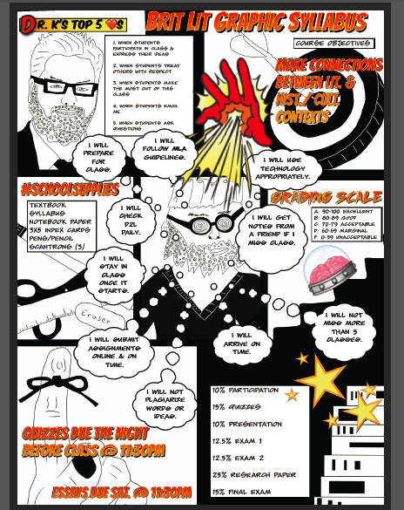

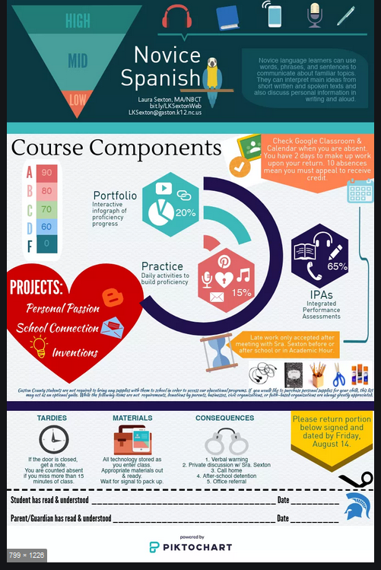
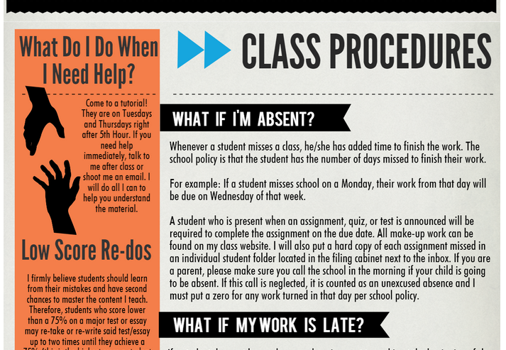
Syllabi that
Connect
Using ComicBook App
Using Microsoft Publisher
ThingLink & PicktoChart Interactive Syllabi
https://www.thinglink.com/scene/670030588752691200
Using PiktoChart

Slide 14


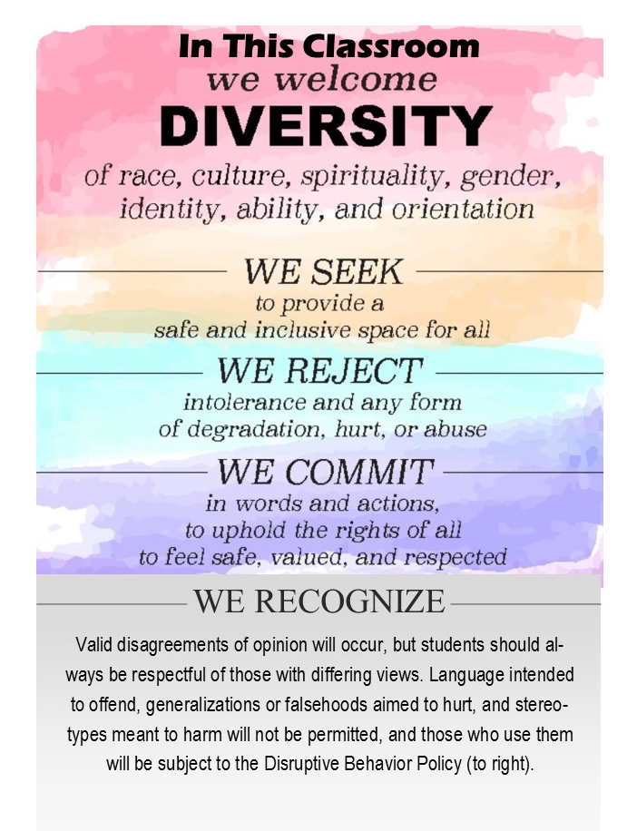

A Clear Theme or Vision for the Class
Clarifies expectations
Helps students know decorum--“Each community has its own set of normative behaviors.” A clear vision help your students avoid “social awkwardness.”

Slide 15
Throughout the Semester for Any Class
Continued scaffolding
Connection 1-on-1 with each student
Access: Provide multiple ways to access you.
Quick response to emails
Testimonials—Provide Words of Wisdom each week from former students.
“Easter eggs” in documents

Slide 16
Throughout the Semester in Any Class
Focus on Connected Learning—how does the class relate to life?
Encourage Vulnerability and Grit:
Share the web of connections that has sustained and supported you through your education (situational humility)
Encourage students to create their own web of connections that can be crucial to thriving in college.

Slide 17
Specific to Face-to-Face Classes
Build student comfort in coming to your office. Suggestions:
  Give extra credit if students find your office/visit office hours
  Receive a grade if students sign in at your office door if they find your office
  Turn in an assignment to your office vs. during class.
Be more available where the students are. Move office hours to building hallways or to times before/after class.
Know students’ names (and call them by their preferred nickname)

Slide 18
Specific to Face-to-Face Classes
Show up early to class and connect with them.
Invite individuals from the academic support programs to make personal connections with your students—Writing Center, Math, library, etc.
For dual credit students at ISD/satellite campuses, build connections to the college by offering extra credit points for coming to campus events/campus services (Writing Center, library, etc.).

Slide 19
Specific to Online Courses
Online icebreaker activities or discussion boards
Online group activities---Each person would have to have a specific role for this to work.
Short check-in videos once or twice a week—Include a little information that makes the instructor a real person.
Emails to each student individually during the semester to “check in”
Creation of user-generated content—Share excellent answers from students in the news page (This would require student approval but could build learning). Refer students to excellent discussion board posts, etc.
Creation of projects where several are doing the same assignment: allow them to work on ideas together.

Slide 20
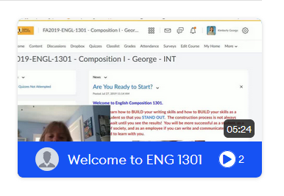
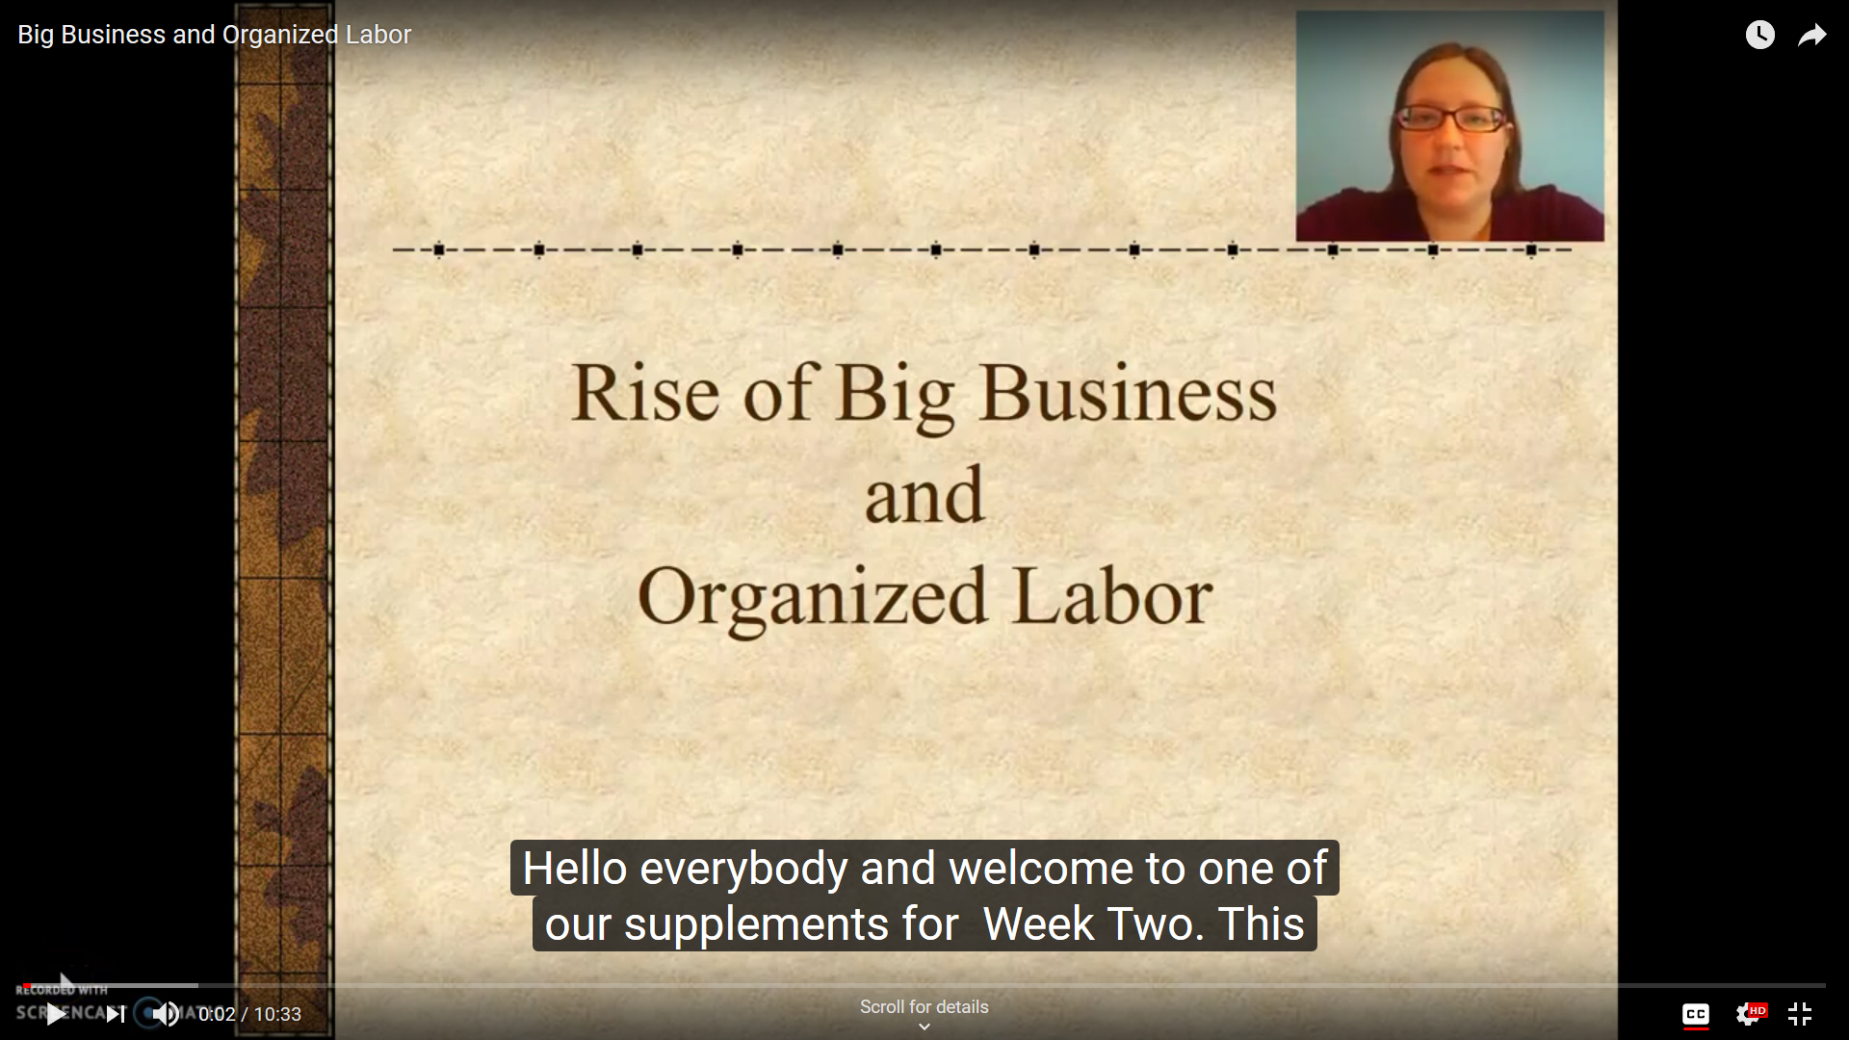
Specific to Online Courses
Videos that provide closed captioning. (FYI: Brian has asked that these stay short due to low bandwidth in some areas):
Screencastomatic videos
Vid Grid

Slide 21
Other Suggestions?

Slide 22
References
Fitch, Edward S. Influencing a Swift Trust for Elevating Communications of a Virtual Learning Community. Abilene Christian University, 2018, digitalcommons.acu.edu/cgi/viewcontent.cgi?article=1115&context=etd.
Fusani, D. S. (1994). "Extra-class" communication: Frequency, immediacy, selfdisclosure, and satisfaction in student-faculty interaction outside the classroom. Journal ofApplied communication Research, 22.232-255.
Goldsmith, D., & Albrecht, T. (1993). The impact of supportive communication networks on test anxiety and performance. Communication Education, 42, 142-158.
Kuh, G. D. (1995). The other curriculum: Out-of-class experiences associated with student learning and personal development. The Journal of Higher Education. 66, 123-155.
Milem, J. F. , & Berger, J, B. (1997). A modified model of college student persistence: Exploring the relationship between Astin's theory of involvement and Tinto's theory of student departure. Journal of College Student Development. 38.387-400.
Mills, Wren. "Starting Strong by Building Community, Social Presence, and Swift Trust." New York Institute of Technology: Weekly Teaching Note, New York Institute of Technology, 14 Sept. 2016, www.nyit.edu/ctl/blog/starting_strong_by_building_community_social_presence_and_swift_trust#.
Pascarella, E. T. , & Terenzini, P. T. (1991). How college affects students: Findings and insights from twenty years of research. San Francisco, CA: Jossey-Bass.
Roberts, Jr., Lionel P., et al. "Individual Swift Trust and Knowledge-Based Trust in Face-to-Face and Virtual Team Members." Journal of Management Information Systems, vol. 26, no. 2, Sept. 2009, pp. 241-79, doi:https://www.researchgate.net/publication/262353138_Individual_Swift_Trust_and_Knowledge-Based_Trust_in_Face-to-Face_and_Virtual_Team_Members.
Sadera, William A., et al. "The Role of Community in Online Learning Success." Journal of Online Learning and Technology, vol. 5, no. 2, June 2009, doi:http://jolt.merlot.org/vol5no2/sadera_0609.pdf.
Terenzini, P. T., Pascarella, E. T., & Blimling, G. S. (1996). Students' out-of-class experiences and their influence on learning and cognitive development: A literature review. Journal of College Student Development. 37, 149-162.

